Slide 1
Review
Learn about linked lists
Become aware of the basic properties of linked lists
Explore the insertion and deletion operations on linked lists
Discover how to build and manipulate a linked list
Learn how to construct a doubly linked list
1

Slide 2
Doubly linked lists
Doubly linked lists
Become aware of the basic properties of doubly linked lists
Explore the insertion and deletion operations on doubly linked lists
Discover how to build and manipulate a doubly linked list
Learn about circular linked list

Slide 3
WHY DOUBLY LINKED LIST
The only way to find the specific node that precedes p is to start at the beginning of the list.
The same problem arias when one wishes to delete an arbitrary node from a singly linked list.
If we have a problem in which moving in either direction is often necessary, then it is useful to have doubly linked lists.
Each node now has two link data members,
  One linking in the forward direction
  One in the backward direction

Slide 4

Introduction
A doubly linked list is one in which all nodes are linked together by multiple links
which help in accessing both the successor (next) and predecessor (previous) node for any arbitrary node within the list.
Every nodes in the doubly linked list has three fields:
  LeftPointer
  RightPointer
  DATA.

Slide 5
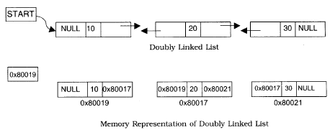
Cont…..
LPoint will point to the node in the left side (or previous node) that is LPoint will hold the address of the previous node.
RPoint will point to the node in the right side (or next node) that is RPoint will hold the address of the next node.
Data will hold the information of the node.

Slide 6
REPRESENTATION OF DOUBLY LINKED LIST
A node in the doubly linked list can be represented in memory with the following declaration.
Struct Node
{
int Data;
struct Node *next;
struct Node *prev;
};

Slide 7
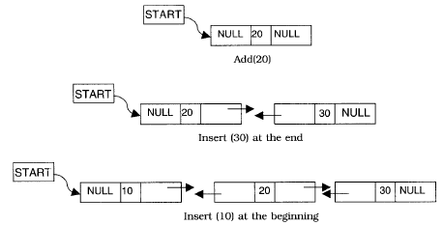

INSERTION AND DELETION OF NODES

Slide 8
Doubly-Linked Lists
It is a way of going both directions in a linked list, forward and reverse.
Many applications require a quick access to the predecessor node of some node in list.

Slide 9
Advantages over Singly-linked Lists
Quick update operations:
such as: insertions, deletions at both ends (head and tail), and also at the middle of the list.
A node in a doubly-linked list store two references:
  A next link; that points to the next node in the list, and
  A prev link; that points to the previous node in the list.

Slide 10




Doubly Linked List
A doubly linked list provides a natural implementation of the List ADT
Nodes implement Position and store:
  element
  link to the previous node
  link to the next node
Special trailer and header nodes
prev
next
elem
node
header
nodes/positions
trailer
elements

Slide 11
Sentinel Nodes
To simplify programming, two special nodes have been added at both ends of the doubly-linked list.
Head and tail are dummy nodes, also called sentinels, do not store any data elements.
Head: header sentinel has a null-prev reference (link).
Tail: trailer sentinel has a null-next reference (link).

Slide 12
What we see from a Doubly-linked List?
A doubly-linked list object would need to store the following:
Reference to sentinel head-node;
Reference to sentinel tail-node; and
Size-counter that keeps track of the number of nodes in the list (excluding the two sentinels).

Slide 13
Empty Doubly-Linked List:
Using sentinels, we have no null-links; instead, we have:
head.next = tail
tail.prev = head
Singl Node List:
Size = 1
This single node is the first node, and also is the last node:
first node is head.next
last node is tail.prev
header
trailer
first
last
header
trailer

Slide 14
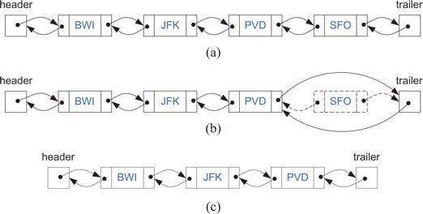
Removal from a Doubly-Linked List
Notice that before removal, we must check for empty list. If not, we will remove the last node in the list, as shown in Figure above.

Slide 15
Insertion
We visualize operation AddAfter(p, X), which returns position q
p
A
B
C
p
A
B
q
C
X
p
q
A
B
X
C

Slide 16
Deletion
We visualize remove(p), where p = last()
p
A
B
C
D
A
B
C
p
D
A
B
C

Slide 17
Performance
In the implementation of the List ADT by means of a doubly linked list
  The space used by a list with n elements is O(n)
  The space used by each position of the list is O(1)
  All the operations of the List ADT run in O(1) time
  Operation element() of the
  Position ADT runs in O(1) time

Slide 18
Node data
info: the user's data
next, back: the address of the next and previous node in the list
.back
.info
.next

Slide 19
Node data (cont.)
template<class ItemType>
struct NodeType {
ItemType info;
NodeType<ItemType>* next;
NodeType<ItemType>* back;
};

Slide 20
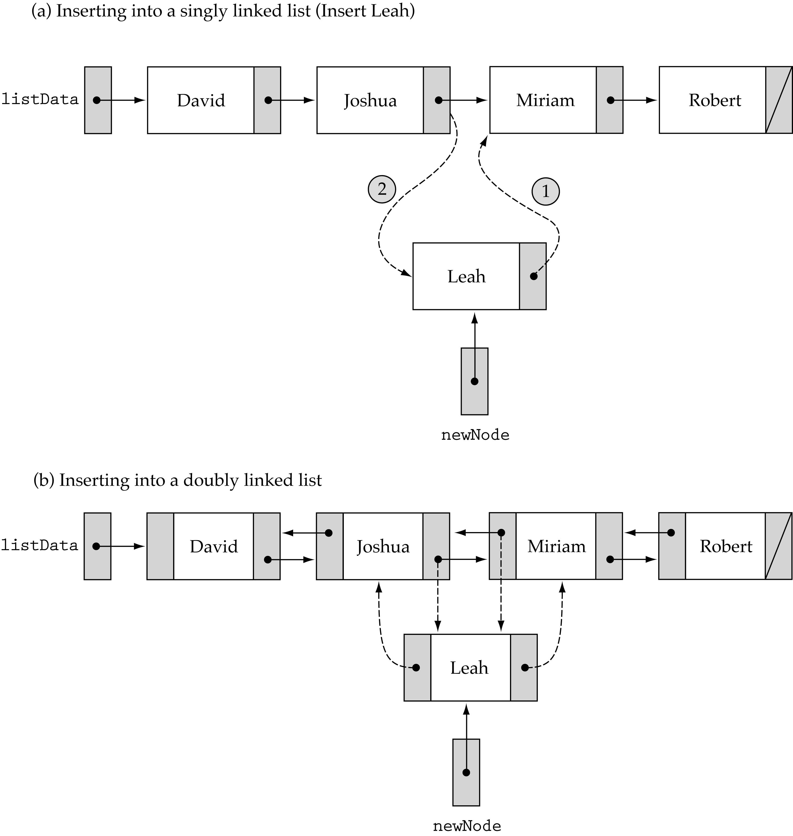
Finding a List Item
We no longer need to use prevLocation (we can get the predecessor of a node using its back member)

Slide 21
Finding a List Item (cont.)

Slide 22
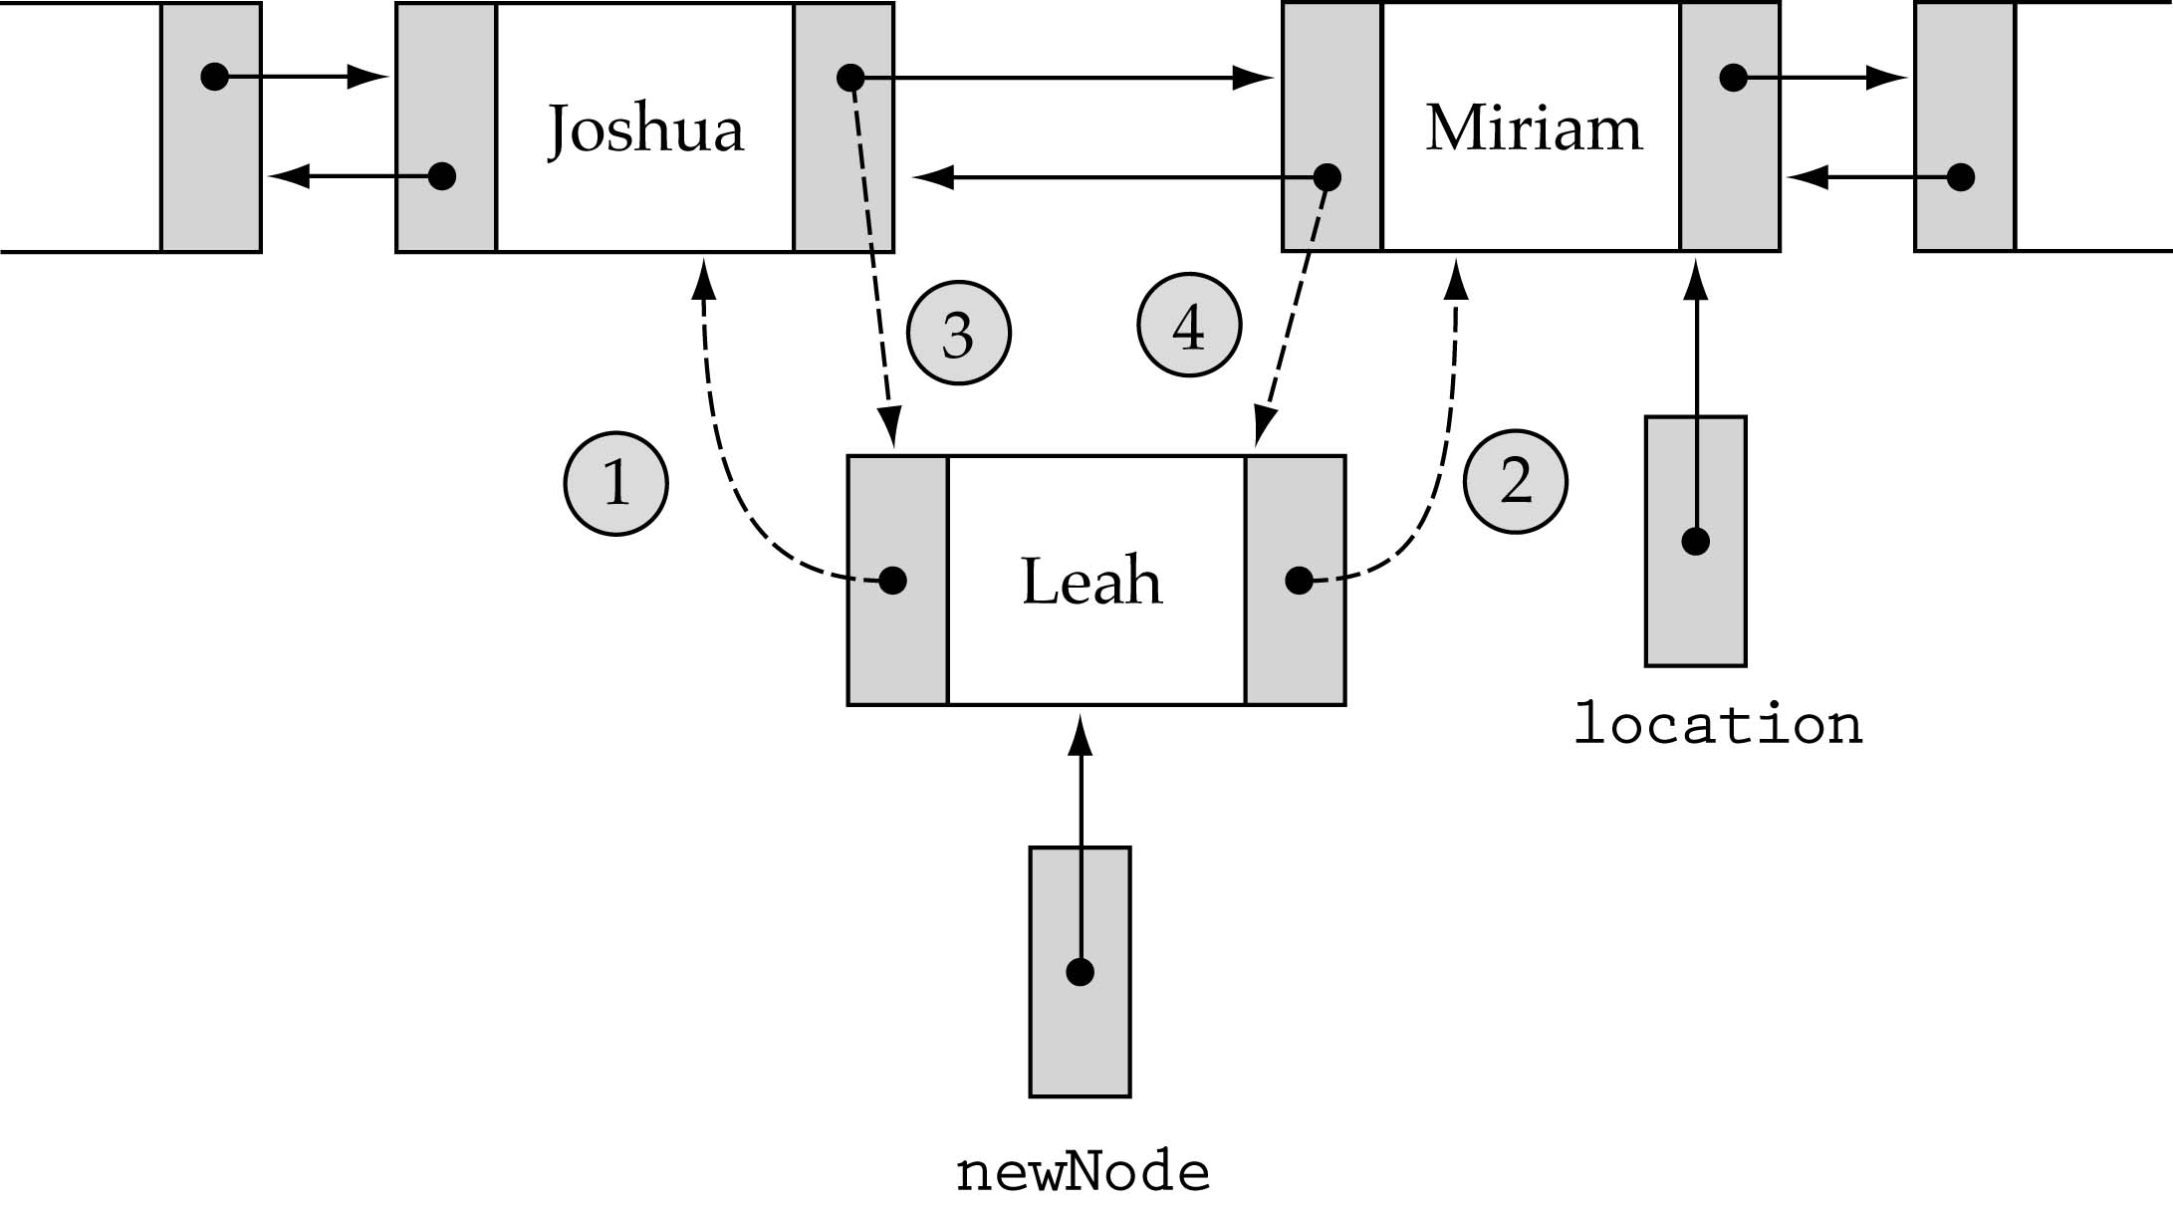
Inserting into a Doubly Linked List
1. newNode->back = location->back; 3. location->back->next=newNode;
2. newNode->next = location 4. location->back = newNode;

Slide 23
FindItem (listData, item, location, found)
RetrieveItem, InsertItem, and DeleteItem all require a search !
Write a general non-member function FindItem that takes item as a parameter and returns location and found.
InsertItem and DeleteItem need location (ignore found)
RetrieveItem needs found (ignores location)

Slide 24
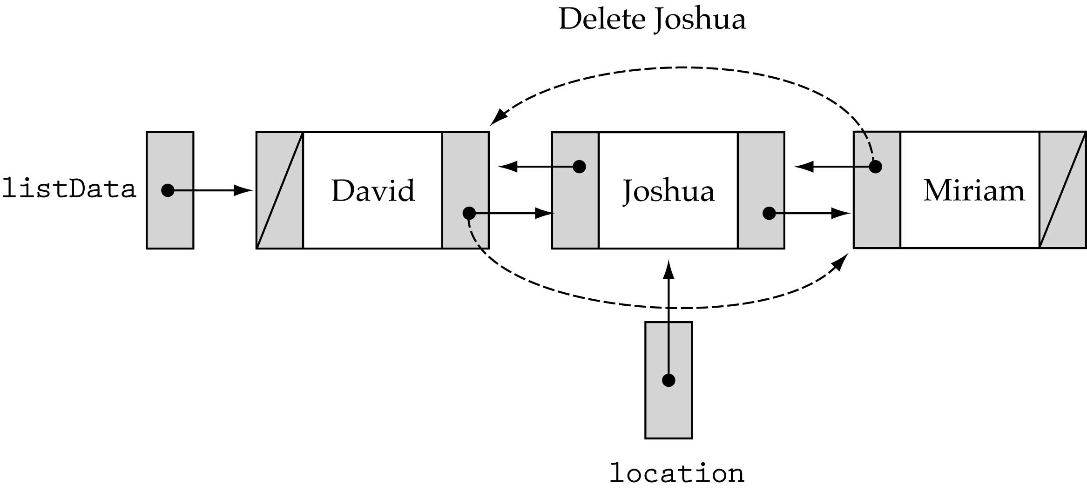
Deleting from a Doubly Linked List
Be careful about the end cases!!

Slide 25
Headers and Trailers
Special cases arise when we are dealing with the first or last nodes
How can we simplify the implementation?
  Idea: make sure that we never insert or delete the ends of the list
  How? Set up dummy nodes with values outside of the range of possible values

Slide 26
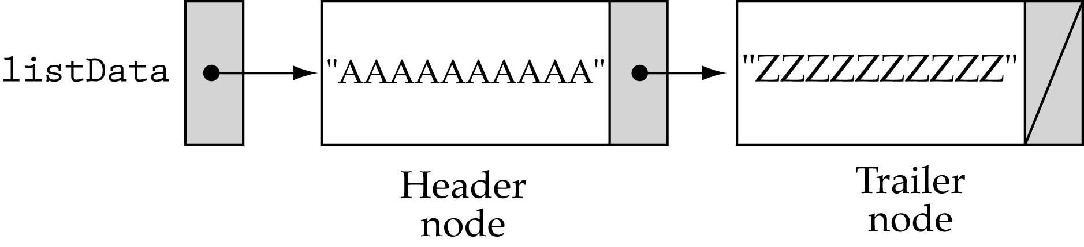
Headers and Trailers (cont.)
Header Node: contains a value smaller than any possible list element
Trailer Node: contains a value larger than any possible list element

Slide 27
A linked list as an array of records
What are the advantages of using linked lists?
  (1) Dynamic memory allocation
  (2) Efficient insertion-deletion (for sorted lists)
Can we implement a linked list without dynamic memory allocation ?

Slide 28
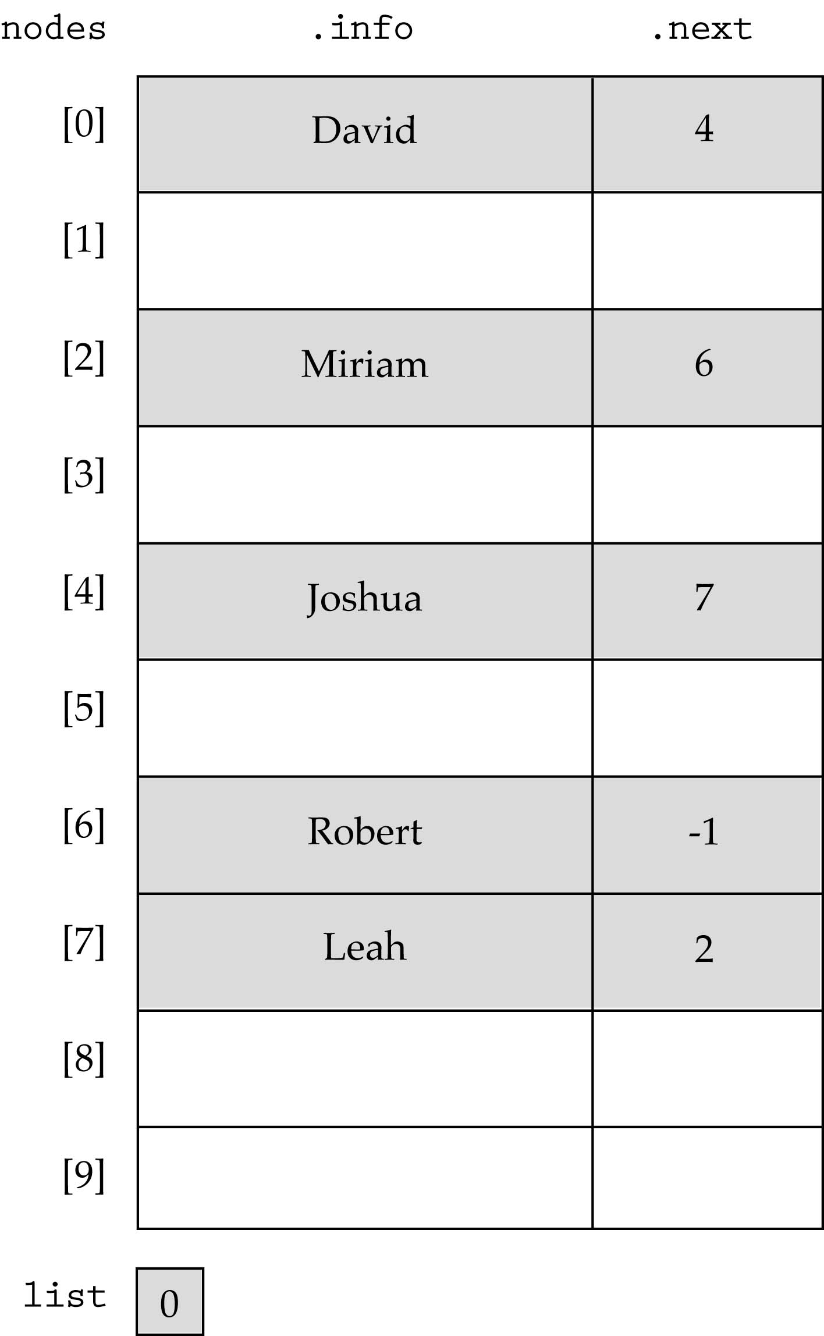
A linked list as an array of records (cont.)

Slide 29
Basic Operations on a Doubly-Linked List
Add a node.
Delete a node.
Search for a node.
Traverse (walk) the list. Useful for counting operations or aggregate operations.
Note: the operations on a doubly-linked list are exactly the same that are required for a singly-linked list. As we discussed before, the reasons for using a doubly-linked list are application dependent for the most part.

Slide 30
Adding Nodes to a Doubly-Linked List
Adding a Node
There are four steps to add a node to a doubly-linked list:
Allocate memory for the new node.
Determine the insertion point to be after (pCur).
Point the new node to its successor and predecessor.
Point the predecessor and successor to the new node.
Current node pointer (pCur) can be in one of two states:
it can contain the address of a node (i.e. you are adding somewhere after the first node – in the middle or at the end)
it can be NULL (i.e. you are adding either to an empty list or at the beginning of the list)

Slide 31
Adding Nodes to an Empty Doubly-Linked List
Initial: Code:
        pNew = (struct node *) /*create node*/
malloc(sizeof(struct dllnode));
pNew -> data = 39;
pNew -> right = pHead;
pNew -> left = pHead;
        pHead = pNew;
After:
pNew
39
pHead
pCur
pNew
39
pHead
pCur

Slide 32
Adding a Node to the Middle of a Doubly-Linked List
Before:
After:
pNew
64
55
124
pCur
pNew
64
55
124
pCur

Slide 33
Adding a Node to the Middle of a Doubly-Linked List
The Code
pNew = (struct node *) malloc(sizeof(struct dllnode));
pNew -> data = 64;
pNew -> left = pCur;
pNew -> right = pCur -> right;
pCur -> right -> left = pNew;
pCur -> right = pNew;

Slide 34
Adding a Node to the End of a Doubly-Linked List
Before:
After:
pNew
84
55
74
pCur
pNew
84
55
74
pCur

Slide 35
Adding a Node to the end of a Doubly-Linked List
The Code
pNew = (struct node *) malloc(sizeof(struct dllnode));
pNew -> data = 84;
pNew -> left = pCur;
pNew -> right = pCur -> right;
pCur -> right = pNew;

Slide 36
Deleting a Node from a Doubly-Linked List
Deleting a node requires that we logically remove the node from the list by changing various links and then physically deleting the node from the list (i.e., return it to the heap).
Any node in the list can be deleted. Note that if the only node in the list is to be deleted, an empty list will result. In this case the head pointer will be set to NULL.
To logically delete a node:
  First locate the node itself (pCur).
  Change the predecessor’s and succesor’s link fields to point each other (see example).
  Recycle the node using the free() function.

Slide 37
Deleting the First Node from a Doubly-Linked List
Before: Code:
pHead = pCur -> right;
pCur ->right -> left = NULL;
free(pCur);
After:
pHead
75
124
pCur
pHead
Recycled
124
pCur

Slide 38
Deleting a Node from a Linked List – General Case
Before:
After:
23
77
75
46
124
pCur
23
Recycled
77
75
124
pCur

Slide 39
Deleting a Node From a Doubly-Linked List
The Code
//delete a node from a linked list
if (pCur -> left == NULL){
//deletion is on the first node of the list
pHead = pCur -> right;
pCur -> right -> left = NULL;
{
else {
//deleting a node other than the first node of the list
pCur -> left -> right = pCur -> right;
pCur -> right -> left = pCur -> left;
}
free(pCur).

Slide 40
Searching a Doubly-Linked List
Notice that both the insert and delete operations on a linked list must search the list for either the proper insertion point or to locate the node corresponding to the logical data value that is to be deleted.
//search the nodes in a linked list
pCur = pHead;
//search until the target value is found or the end of the list is reached
while (pCur != NULL && pCur -> data != target) {
pCur = pCur -> right;
}
//determine if the target is found or ran off the end of the list
if (pCur != NULL)
found = 1;
else
found = 0;

Slide 41
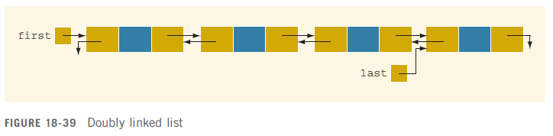
Doubly Linked Lists
Doubly linked list: every node has next and back pointers
Can be traversed in either direction

Slide 42
Doubly Linked Lists (cont'd.)
Operations:
  Initialize the list
  Destroy the list
  Determine whether the list is empty
  Search the list for a given item
  Retrieve the first element of the list
  Retrieve the last element of the list

Slide 43
Doubly Linked Lists (cont'd.)
  Insert an item in the list
  Delete an item from the list
  Find the length of the list
  Print the list
  Make a copy of the doubly linked list

Slide 44
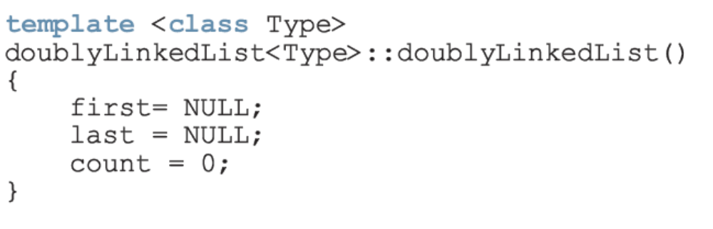
Default Constructor

Slide 45
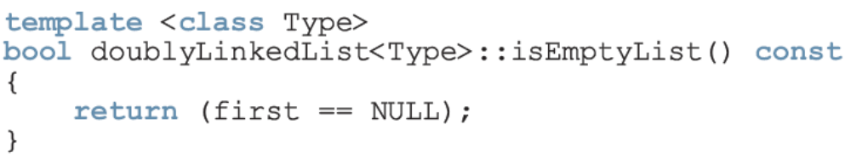
isEmptyList

Slide 46
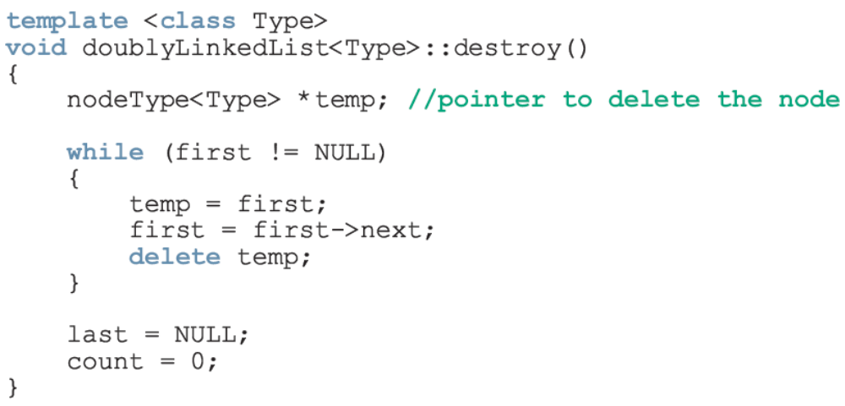
Destroy the List
This operation deletes all the nodes in the list, leaving the list in an empty state

Slide 47
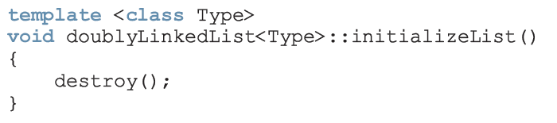
Initialize the List
This operation reinitializes the doubly linked list to an empty state

Slide 48
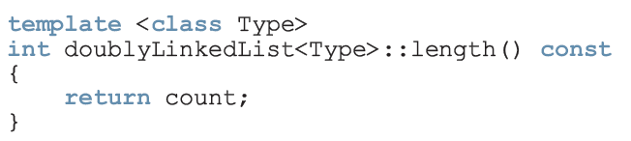
Length of the List

Slide 49
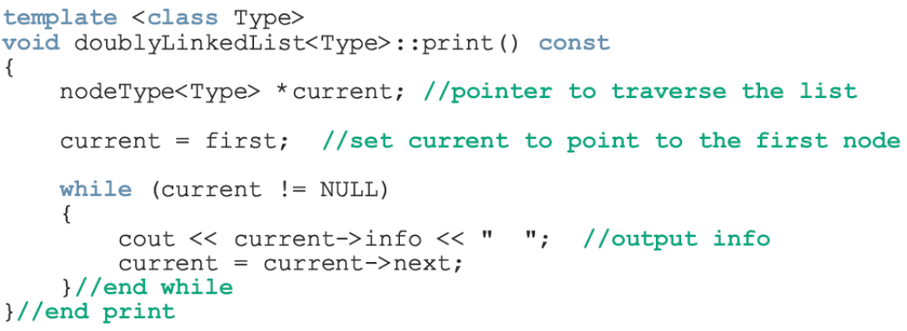
Print the List

Slide 50
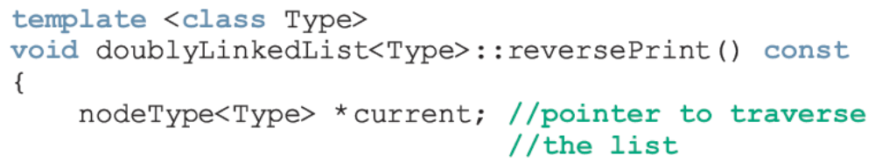
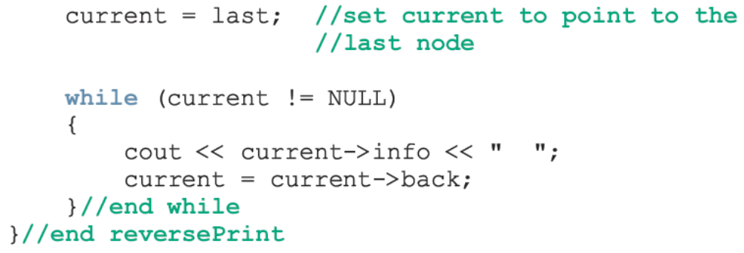
Reverse Print the List

Slide 51
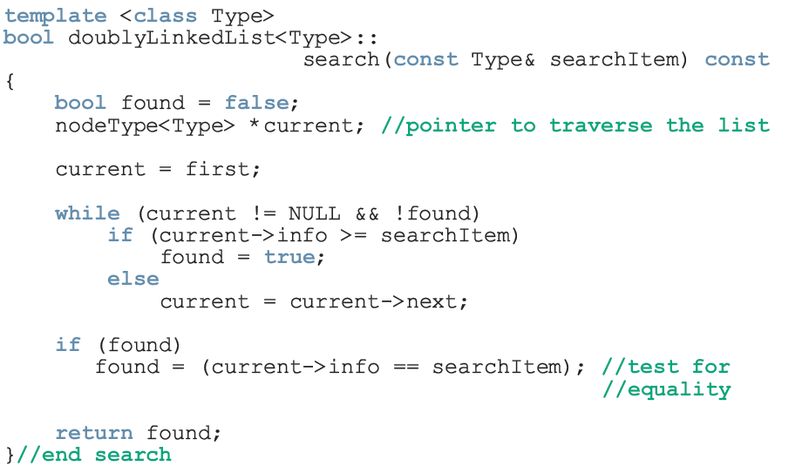
Search the List

Slide 52
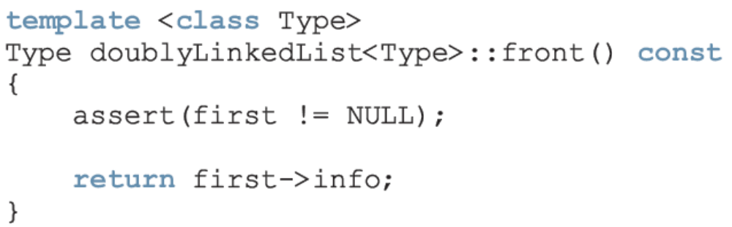
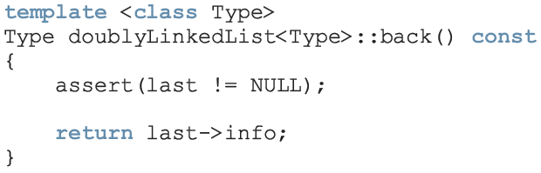
First and Last Elements

Slide 53
Insert a Node
There are four cases:
  Case 1: Insertion in an empty list
  Case 2: Insertion at the beginning of a nonempty list
  Case 3: Insertion at the end of a nonempty list
  Case 4: Insertion somewhere in nonempty list
Cases 1 and 2 require us to change the value of the pointer first
Cases 3 and 4 are similar (after inserting an item, count is incremented by 1)

Slide 54
Delete a Node
Case 1: The list is empty
Case 2: The item to be deleted is in the first node of the list, which would require us to change the value of the pointer first
Case 3: Item to be deleted is somewhere in the list
Case 4: Item to be deleted is not in the list
After deleting a node, count is decremented by 1

Slide 55
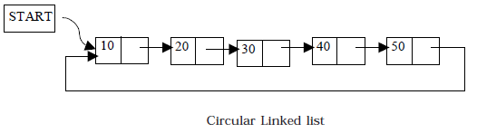
Circular Linked list
A circular linked list is one, which has no beginning and no end.
A singly linked list can be made a circular linked list by simply storing the address of the very first node in the linked field of the last node.

Slide 56
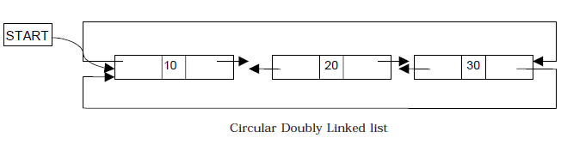
Cont…..
A circular doubly linked list has both the successor pointer and predecessor pointer in circular manner.

Slide 57
Review
Doubly linked lists
Become aware of the basic properties of doubly linked lists
Explore the insertion and deletion operations on doubly linked lists
Discover how to build and manipulate a doubly linked list
Learn about circular linked list

